Slide 1
C++ For C Coders 1
Start a console
PS, cmd, bash
Revisiting installation of g++
C vs C++
In-house programming principles
VS Code
Hello World

Slide 2
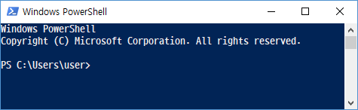
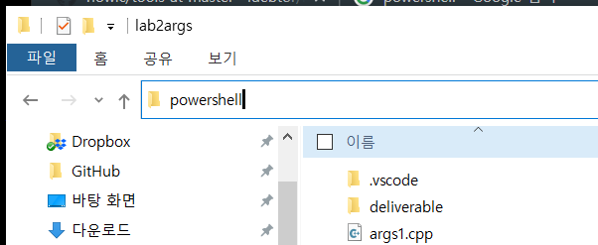
Start a console at your folder
Start PowerShell through "Start" menu
Move to the folder you want to start.
Enter 'powershell' at the File Explorer

Slide 3
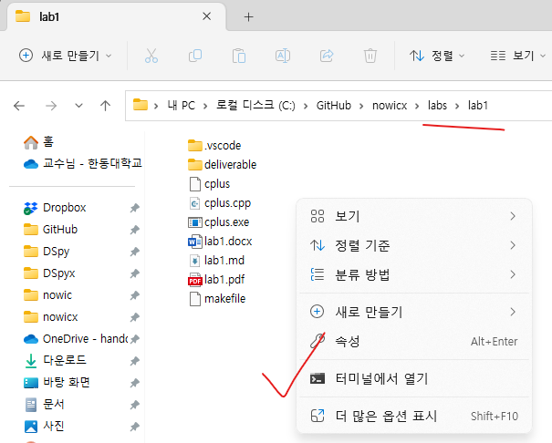
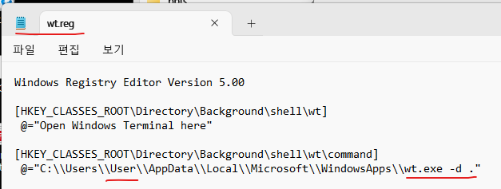
Start a "Windows Terminal" at the current folder in File Explorer
Download "Windows Terminal" from MS Store.
Have "wt.reg" file ready to add it to the registry. Replace "User" in "wt.reg" shown below with your user's name of the Windows.
Merge[병합] it to the registry. (Click right on the file "wt.reg" and choose "병합")
You may restart the Windows if it is not effective immediately.

Slide 4
PowerShell, Cmd, vs Bash (Borne-again shell), sh, ksh, csh
PowerShell (Cmdlet) | PowerShell (Alias) | Windows Cmd | Unix shell | Description
Get-ChildItem | gci, dir, ls | dir | ls | Lists all files and folders in the current or given folder
Get-Content | gc, type, cat | type | cat | Gets the content of a file
Get-Command | gcm | help | type, which | Lists available commands
Get-Help | help, man | help | man | Prints a command's documentation on the console
Clear-Host | cls, clear | cls | clear | Clears the screen
Copy-Item | cpi, copy, cp | copy, xcopy | cp | Copies files and folders to another location
Move-Item | mi, move, mv | move | mv | Moves files and folders to a new location
Remove-Item | ri, del, rmdir, rd, rm | del, rmdir, rd | rm, rmdir | Deletes files or folders
Rename-Item | rni, ren, mv | ren, rename | mv | Renames a single file, folder, hard link or symbolic link
Get-Location | gl, cd, pwd | cd | pwd | Displays the working path (current folder)
Pop-Location | popd | popd | popd | Changes the working path to the location most recently pushed onto the stack
Push-Location | pushd | pushd | pushd | Stores the working path onto the stack
Set-Location | sl, cd, chdir | cd, chdir | cd | Changes the working path, cd .. (move to parent folder), cd ~ (move to HOME folder)
Write-Output | echo, write | echo | echo | Prints strings or other objects to the standard output
Get-Process | gps, ps | tlist, tasklist | ps | Lists all running processes
Stop-Process | spps, kill | kill, taskkill | kill | Stops a running process
Select-String | sls | findstr | find, grep | Prints lines matching a pattern
Set-Variable | sv, set | set | env, export, set, setenv | Creates or alters the contents of an environment variable

Slide 5
PowerShell, Cmd, vs Bash (Borne-again shell), sh, ksh, csh
This Linux Command Handbook covers 60 core Bash commands you will need as a developer.
Each entry includes example code and tips for when to use that command.
https://www.freecodecamp.org/news/the-linux-commands-handbook/

Slide 6
Install GNU C/C++ Compiler (MSYS2 first, MinGW-w64 next)
MSYS = "Minimal SYStem", is a Bourne Shell command line interpreter system MinGW = "Minimalist GNU for Windows“
Install MSYS2 first from http://www.msys2.org/ Then use a command at the msys2 window.
$ pacman -Syu $ pacman -S mingw-w64-x86_64-gcc
Add the following path to the PATH environment variable
C:/msys64/mingw64/bin # for g++
C:/msys64/usr/bin # for commands such as ls, cat, rm
Add .bash_profile
C:/msys64/home/user/.bash_profile # a sample is provided
be cautious, not 'user'
check your home folder

Slide 7
.bash_profile (an example) in C:\msys64\home\user
alias ls='ls -Gp --color=auto'
alias ll='ls –alkF'
alias rm='rm -i'
alias h='history'
LS_COLORS=$LS_COLORS':no=00:di=36;01'
LS_COLORS=$LS_COLORS':*.h=1;33:*.exe=31:*.o=1;32:*.md=1;33'
export LS_COLORS
export PATH=$PATH:"/c/msys64/mingw64/bin"
export PATH=$PATH:"/c/msys64/usr/bin"
export PATH=$PATH:"/c/Program Files/Git/bin"
export PATH=$PATH:"/c/Users/$USER/AppData/Local/Programs/Microsoft VS Code/bin"
# code () { VSCODE_CWD="$PWD" open -n -b "com.microsoft.VSCode" --args $* ;}
# Setting my dev folder as a startup folder of msys.
HOME="/c/GitHub/nowic"
cd $HOME
echo $PWD
# @$(hostname) may be added, if necessary, after $(whoami)
GREEN="$(tput setaf 2)"
RESET="$(tput sgr0)"
PS1='${GREEN}$(pwd -W)> ${RESET}'
This is the folder Code is installed.
For macOS
check your github folder

Slide 8
.bash_profile (an example) in C:\msys64\home\user
For macOS
Open a terminal & run the following commands
참고: https://qastack.kr/superuser/886132/where-is-the-zshrc-file-on-mac
> touch ~/.zshrc # 폴더와 파일 생성
> open ~/.zshrc # 파일 열고, .bash_profile 내용 입력
Close the file and reopen a terminal.
alias ls='ls -Gp --color=auto'
alias ll='ls –alkF'
alias rm='rm -i'
alias h='history'
LS_COLORS=$LS_COLORS':no=00:di=36;01'
LS_COLORS=$LS_COLORS':*.h=1;33:*.exe=31:*.o=1;32:*.md=1;33'
export LS_COLORS
export PATH=$PATH:"/c/msys64/mingw64/bin"
export PATH=$PATH:"/c/msys64/usr/bin"
export PATH=$PATH:"/c/Program Files/Git/bin"
export PATH=$PATH:"/c/Users/$USER/AppData/Local/Programs/Microsoft VS Code/bin"
# code () { VSCODE_CWD="$PWD" open -n -b "com.microsoft.VSCode" --args $* ;}
# Setting my dev folder as a startup folder of msys.
HOME="/c/GitHub/nowic"
cd $HOME
echo $PWD
# @$(hostname) may be added, if necessary, after $(whoami)
GREEN="$(tput setaf 2)"
RESET="$(tput sgr0)"
PS1='${GREEN}$(pwd -W)> ${RESET}'
This is the folder Code is installed.
Uncomment for macOS
check your github folder

Slide 9
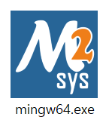
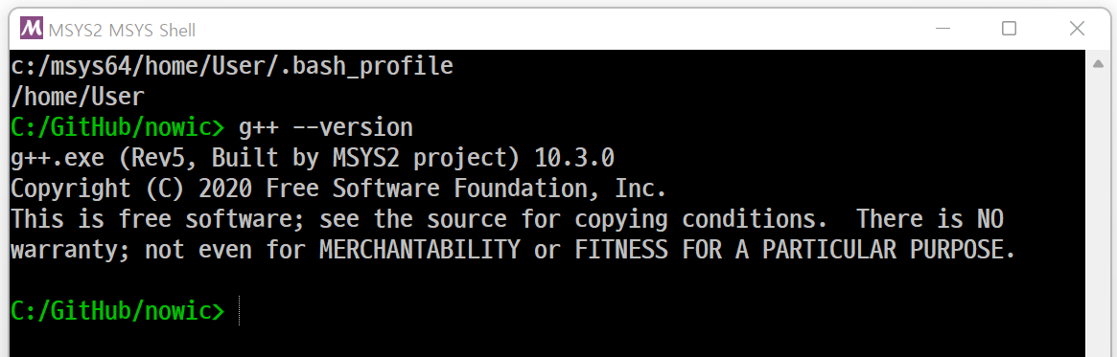
How to test .bash_profile in C:\msys64\home\user
Open a terminal & run the following commands
참고: https://qastack.kr/superuser/886132/where-is-the-zshrc-file-on-mac
> touch ~/.zshrc # 폴더와 파일 생성
> open ~/.zshrc # 파일 열고, .bash_profile 내용 입력
Close the file and reopen a terminal.
For windows users, after adding .bash_profile as shown below:
C:/msys64/home/user/.bash_profile # a sample is provided
Create a short-cut from /msys64/mingw64.exe.
Double click the short-cut and test g++ installation as shown below:

Slide 10
C++ for C Coders
C
Dennis Ritchie
1972
29 Keywords
Procedural programming
C++
Stroustrup
1985
63 Keywords by 1996
C++ as a better C
Object-oriented programming
Generic programming STL(Standard Template Library)
“Swiss Army Knife”

Slide 11
C++ specific keywords
asm dynamic_cast namespace reinterpret_cast try
bool explicit new static_cast typeid
catch false operator template typename
class friend private this using
const_cast inline public throw virtual
delete mutable protected true wchar_t

Slide 12
From C to C++
Even if C++ is slanted toward object-oriented programming (OOP), you can nevertheless use any C++ compiler to compile C code and benefits from some C++ goodies.
C++ as a better C

Slide 13
In-house Programming Principles
DRY or DIE
Don't repeat yourself, or Duplication is Evil.
To make you professional coders and save time.
KISS
Keep it simple, stupid!, Keep it simple and short.
To make you professional coders – code maintainable
NMN
No magic number
To make you professional coders - code robust.
NSE
No side effects
To make you professional coders - code clean.

Slide 14
Source Code Editor: Visual Studio Code
Code is an open source and a cross-platform editor software developed by Microsoft. It becomes one of the best code editors in the market, lately.
Features:
IntelliSense - autocomplete
Refactoring
Run and Debug
Built-in Git
Extensions
Refer to the following documents in nowic/tools
VSCode Step1. GCC 및 MSYS2 설치.pdf
VSCode Step2. C C++ 코딩 준비.pdf
VSCode Step3. Makefile 사용 방법.pdf
VSCode Step4. JSON 파일 설정 및 사용 방법.pdf
VSCode Step5. 코딩 및 디버깅 테스트.pdf

Slide 15
Write "Hello World" program in C++
Open Code editor
$ code hello.cpp
Add the source code.
Save the file.
Compile and Execute
$ g++ hello.cpp
$ ./a.exe
$ ./a $ a
// file: hello.cpp
#include <iostream>
int main() {
std::cout << "Hello World!" << std::endl;
}
Scope Resolution Operator(::)
PowerShell
macOS
cmd
// file: hello.cpp
#include <iostream>
using namespace std;
int main() {
cout << "Hello World!" << endl;
}
Without using Scope Resolution Operator(::)

Slide 16
C++ For C Coders 1
Start a console
PS, cmd, bash
Revisiting installation of g++
C vs C++
In-house programming principles
Hello World

